Slide 1
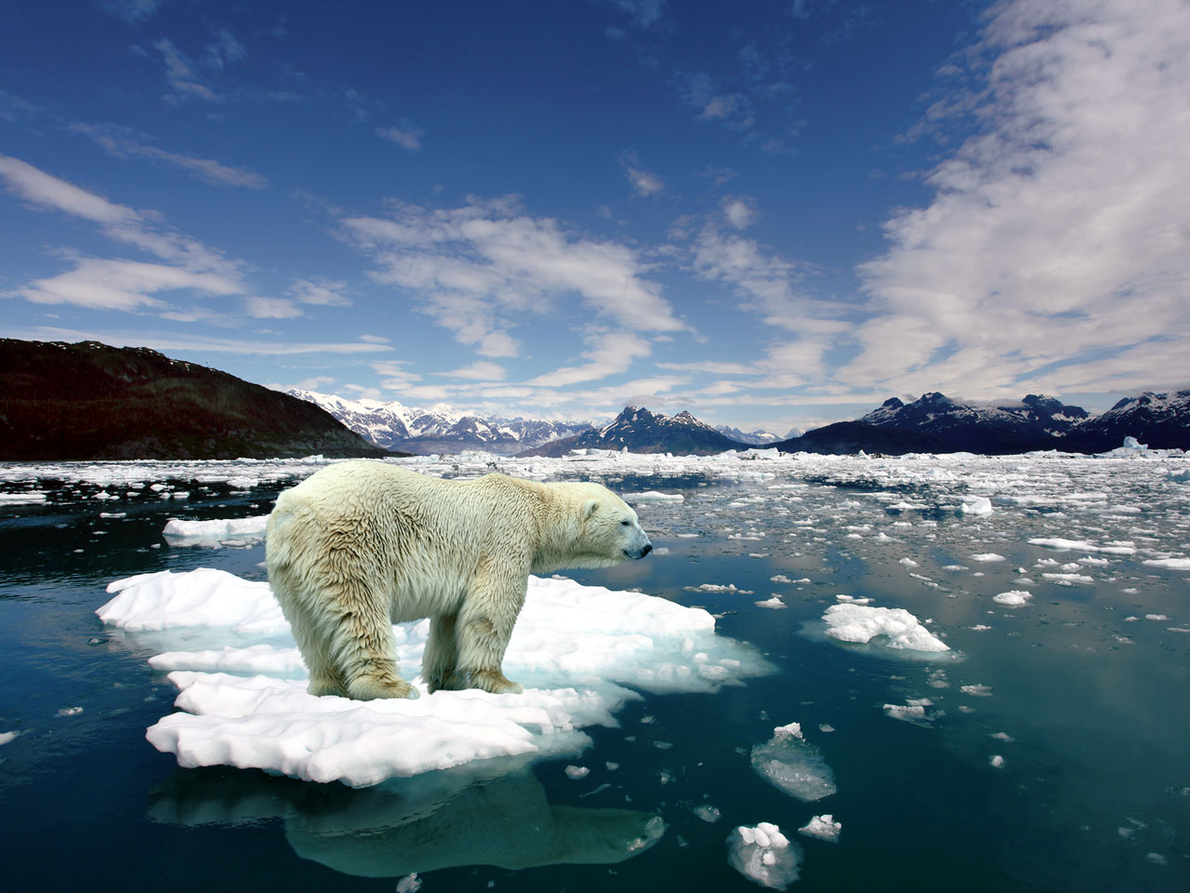

The 5-year vision for the Arctic Spatial Data Infrastructure - Lessons for Canada’s North
Enabling Access to Arctic Spatial Data Across Borders, Across Time, Across Cultures
Governance, Standards and Policy provide a generic roadmap for Canadian Stakeholder discussions
Cameron Wilson & Simon Riopel
GeoConnections, Canada Centre for Mapping and Earth Observation, Natural Resources Canada and Partners
http://wallpaper.imcphoto.net/animals/polar-bear/polar-bear-on-ice.jpg
Notes:
The Arctic Spatial Data Infrastructure is:
• Enabling Access to Spatial Data Across Borders, Across Time
The Arctic Spatial Data Infrastructure is also:
• providing governance and Multi-Jurisdictional Data Sharing mechanisms

Slide 2
Canada and the Circumpolar Arctic - Global Affairs Canada
“The Arctic is central to Canada’s national identity, prosperity, security, values and interests. The Canadian Arctic covers 40% of Canada’s territory and is home to more than 200,000 inhabitants, more than half of whom are Indigenous.”
Advancing Canada’s Arctic priorities involve many departments across the Government of Canada, both at home and internationally.
Canada is committed to addressing:
The causes and impacts of climate change;
Renewing the nation-to-nation relationship with Indigenous peoples;
Supporting sustainable Northern economic development;
Promoting Canada as a leader in Arctic science and research; and
Working with domestic and international partners to reach Canada’s goals in the region.”
From: https://www.international.gc.ca/world-monde/international_relations-relations_internationales/arctic-arctique/index.aspx?lang=eng

Slide 3
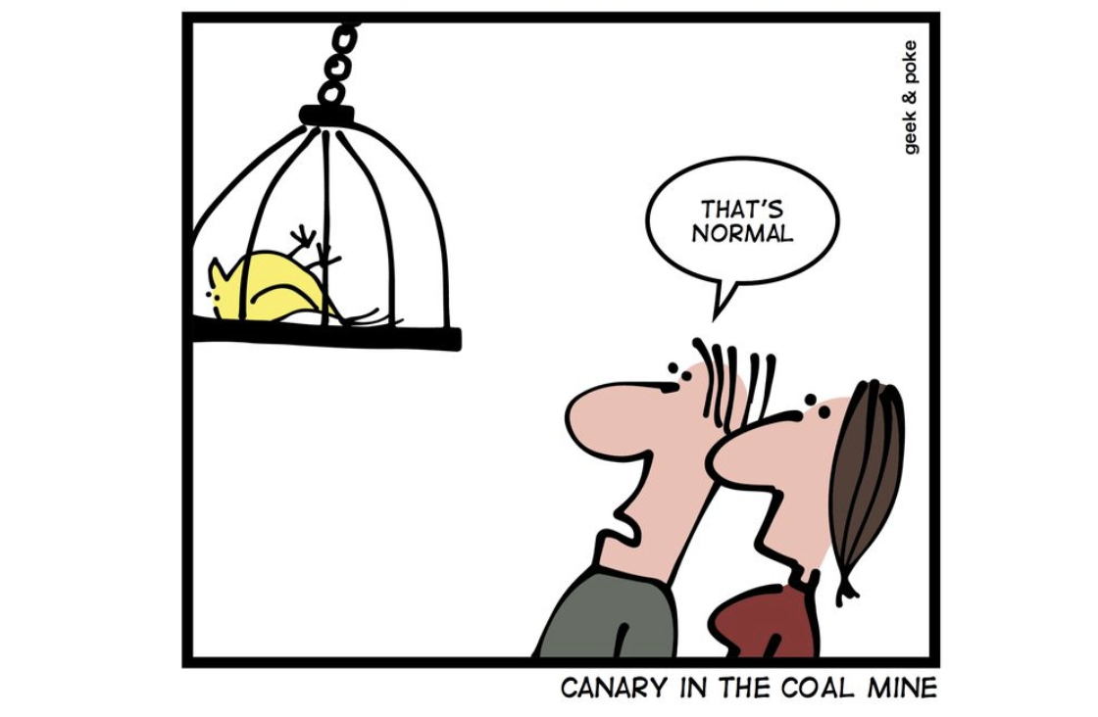
Polar regions are the Canaries in the coal mine for Earth. Indicators are geospatial - in space and time
Carbon levels (atmosphere, ice, capture)
Temperatures on sea and land
Permafrost loss: methane release, coastal erosion and infrastructure destruction
Sea ice loss and increased marine navigation
Species migration patterns and habitat loss.
Irreversible feedback loops
Impacts on societies and economies.

Slide 4
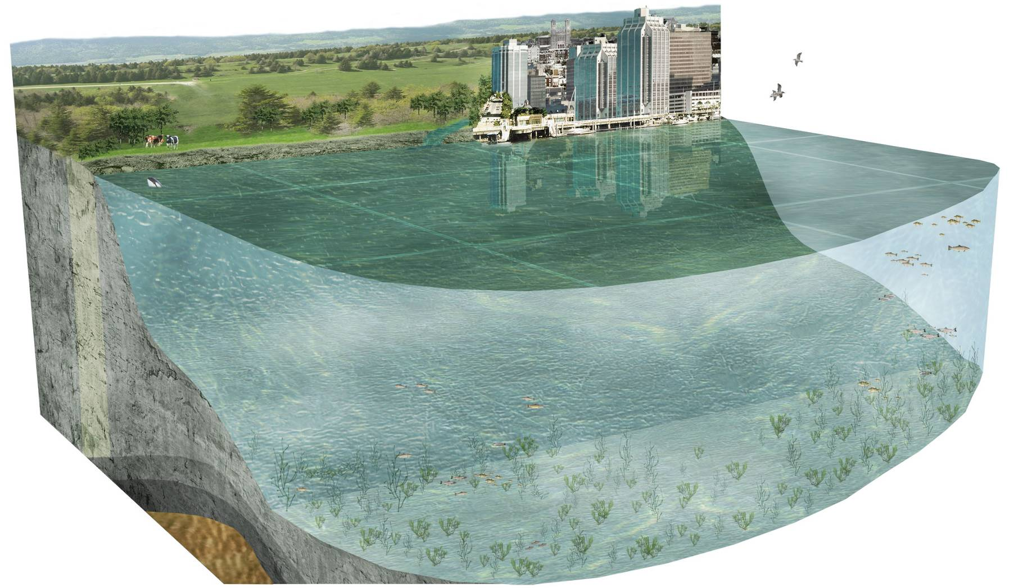
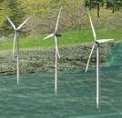
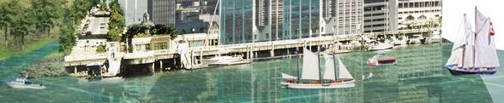
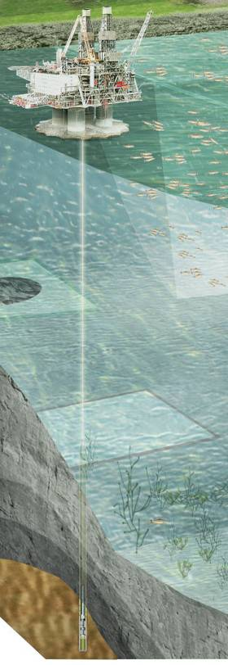
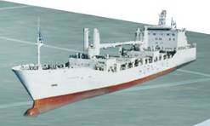
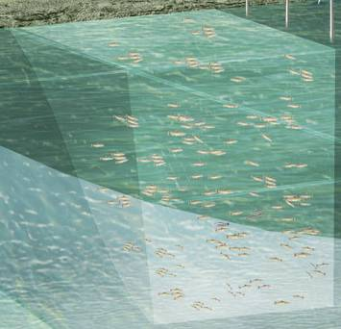
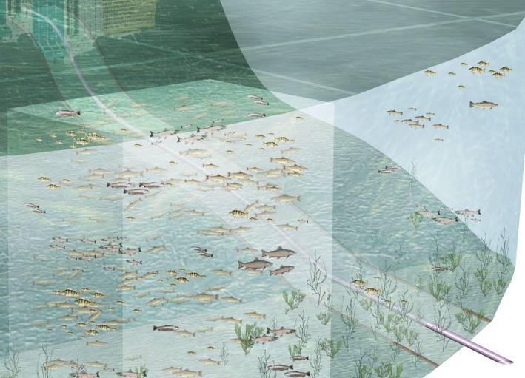
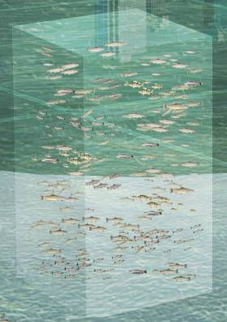
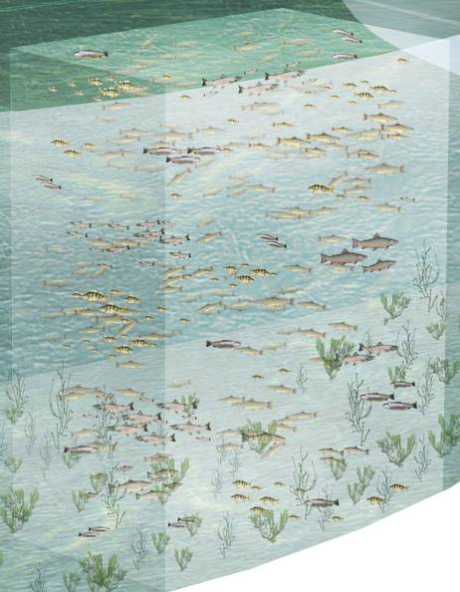

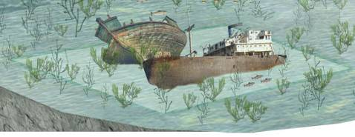
Towards a Digital Arctic
A Domestic imperative within a circumpolar ecosystem reality due to climate change.
Foundation of Governance and Standards.
2025 Arctic Spatial Data Infrastructure Strategy
Location (X,Y & DGGS)
Elevation from geology to atmosphere (Z)
Temporal (T)
Science and Information (S)
Vectors of direction and magnitude (V)
Many stakeholders
Automated and standardized broker services – modest level of effort for each stakeholder
Renewable Energies
Recreation
Oil and gas resources
Aquaculture
Marine protected area
Shipping
Fishing zone
Ocean disposal
Cables and pipelines
Heritage protection
Notes:
Arctic SDI is actively collaborating with Arctic stakeholders to create a seamless multidimensional “Digital Arctic” that will link the land, atmosphere, and marine Arctic domains within an integrated platform.
The dimensions will comprise location (X, Y, or other coordinates), elevation/bathymetry/altitude, time, science and information, and flows to measure pathways and directions (e.g., currents, migrations, icebergs, ice flows, etc.).
------
Six Dimensions are:
X, Y, Z from numerous co-ordinate systems
T - Time
S – Science and literature
V – Vectors of force and direction (currents, migration, ice)

Slide 5
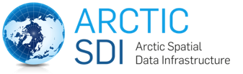
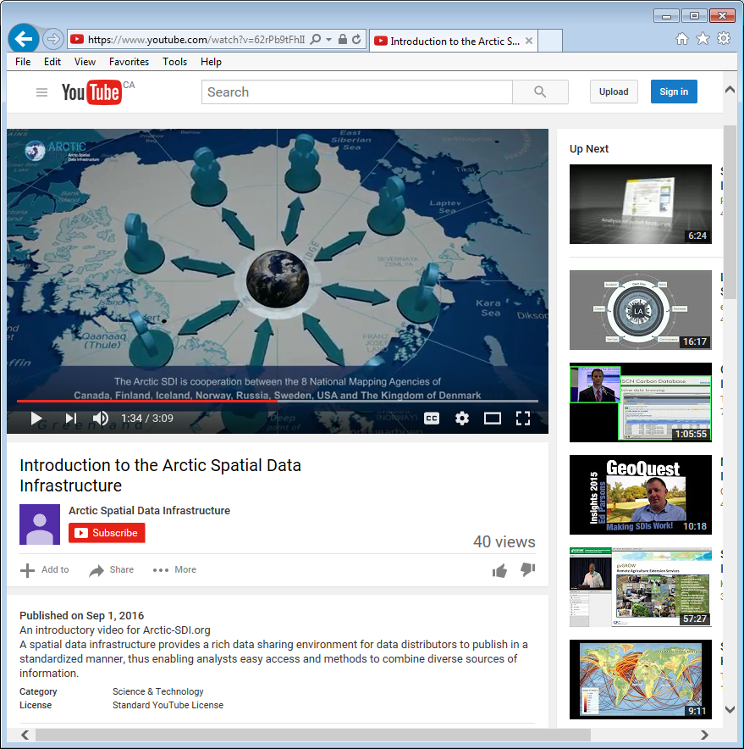
A Model of Effective Collaboration
Arctic SDI is:
endorsed by the Arctic Council (Global Affairs Canada) in 2009 with working groups across federal departments
recognized by Senior Arctic Officials for improving data integration, sharing and analysis across the Arctic
a voluntary collaboration of the eight circumpolar National Mapping Agencies
governed by a Memorandum of Understanding (MOU) in 3 languages,
a domestic imperative in recognition of a shared circumpolar ecosystem that is changing rapidly with global impacts due to a warming climate
By facilitating and building a diverse infrastructure:
Governance, Standards, Policy, Data, Science and Technologies
With a 2025 8 Country Strategy supporting a Digital Arctic (Digital Twin)
Domestically Canada is well positioned to achieve that and more
Based on foundations of solid governance and standards
Seamless sharing of geospatial data across jurisdictions to monitor and predict change.
Information Management Best Practices based on standards that drive an inclusive framework with circumpolar agencies
https://youtu.be/tGS1rcaJRug
Notes:
The Arctic SDI is a collaborative initiative of the National Mapping Agencies of the eight Arctic nations with a goal to promote partner-based development of an Arctic Spatial Data Infrastructure (SDI).
The foundation for the Arctic SDI is the legally non-binding “Memorandum of Understanding” (MOU).
The aim of the Arctic SDI is to provide politicians, governments, policy makers, scientists, private enterprises and citizens in the Arctic with access to geographically related Arctic data, digital maps, analytics, change detection, predictive modeling and tools for northern and remote communities to facilitate monitoring and decision making.
The Arctic SDI is endorsed by Global Affairs Canada.

Slide 6
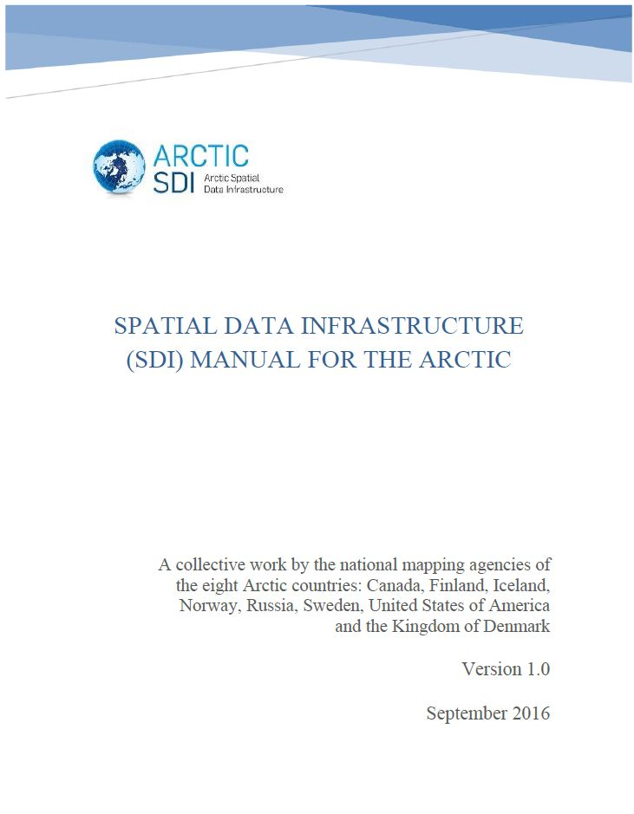
Policy Instruments
Multilateral MoUs and agreements based voluntary contributions without legal implications
User Needs Analysis rigor, publication, and client engagement (see 2:35 presentation)
SDI assessment framework supported by Key Performance Indicators
Glossary of terms used to minimize mult-lingual, multi-cultural misunderstandings
Excellent collegiality – agencies contribute based on their strengths and resources
The SDI Manual for the Arctic describes data management practices and guidelines for efficient monitoring and decision making in the Arctic.
Notes:
Two types of policies are required for a SDI context: strategic and operational policies.
Strategic policies create a formal structure within which the SDI initiative can develop. They encourage stakeholder commitment to participate in the development of and to use the infrastructure.
Operational policies address topics related to the lifecycle of spatial datasets (i.e., their collection, management, dissemination, and use), their delivery, access and use through the SDI, and the operation of the SDI. They are practical tools to build, access and use the infrastructure.

Slide 7

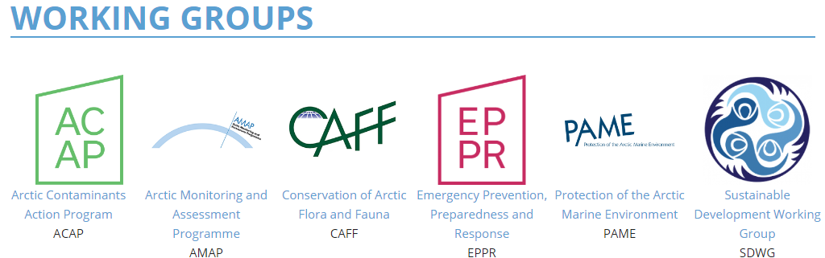
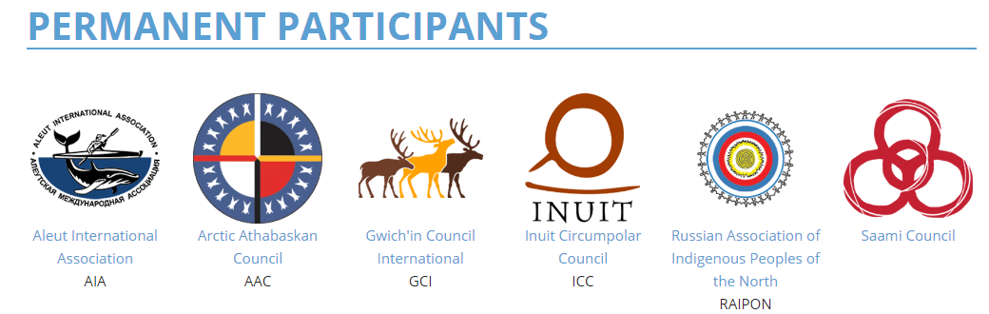
Arctic Council
Arctic Council WG | Federal Department - Head of Delegation
CAFF | Canadian Wildlife Service, Environment and Climate Change Canada
EPPR | Canadian Coast Guard
AMAP | Crown-Indigenous Relations and Northern Affairs Canada
PAME | Department of Fisheries and Oceans
SDWG | Crown-Indigenous Relations and Northern Affairs Canada
ACAP | Environment and Climate Change Canada
Notes:
This initiative supports Arctic Council (AC) priorities, where joint projects and engagement activities were initiated with Arctic Council Secretariat, Working Groups and Permanent Participants, representing the six circumpolar Indigenous organizations. Arctic SDI is recognized by Senior Arctic Officials for improving data integration, sharing and analysis across the Arctic.
Note Indigenous Permanent Participants and Federal Departments. Note there are hidden linkages with Academic or Scientific bodies including Sustaining Arctic Observing Networks, Arctic Data Committee and various other scientific domains.

Slide 8
Arctic Council requirement “Ecosystem-based management”
To monitor the circumpolar Arctic requires data from many jurisdictions and agencies
Nested International Governance structures of Arctic Council, Arctic SDI, Standards Development Agencies (OGC, ISO, IHO, W3C), Arctic Data Committee, UN.
Domestic Governance (Canadian Council on Geomatics, Canadian Consortium for Arctic Data Interoperability, Canada Forum)
Arctic Spatial Data Infrastructure builds on “networks of networks” of data feeds and services. Standards!
Federated data, componentized, time series, multi-cultural.

Slide 9
A Generic SDI Model – Arctic SDI example
Governance Arctic Council, Arctic SDI, UN-GGIM, IHO | Policy Drivers Ecosystems based monitoring – Arctic Council Science and Technology Innovation | SDI Operational Policy MoU, SDI Assessments, Operations, Manuals, Requirements, Key Performance Indicators
 | Applications Arctic SDI GeoPortal; Arctic Council Conservation of Arctic Flora and Fauna – Arctic Biodiversity Data Service, Web Harvesting
 | Standards & Web Services Open Geospatial Consortium, International Hydrographic Organization, International Organization for Standards (ISO)
 | Circumpolar Secondary Data Topographic, Hydrographic, DEM, Wetlands, Gazetteer, Science
 | Primary Data Satellite Imagery, Sensor Networks
Notes:
Arctic SDI is being developed as a “system of systems” to improve access to standardised
geospatial data services delivered by local, national, regional and global providers!
●Arctic SDI working with organizations to make their data available, with a focus on the Arctic Council
●In order to achieve this, the needs and requirements of stakeholders are gathered and analysed
●Standards are playing a key role to ensure interoperability

Slide 10
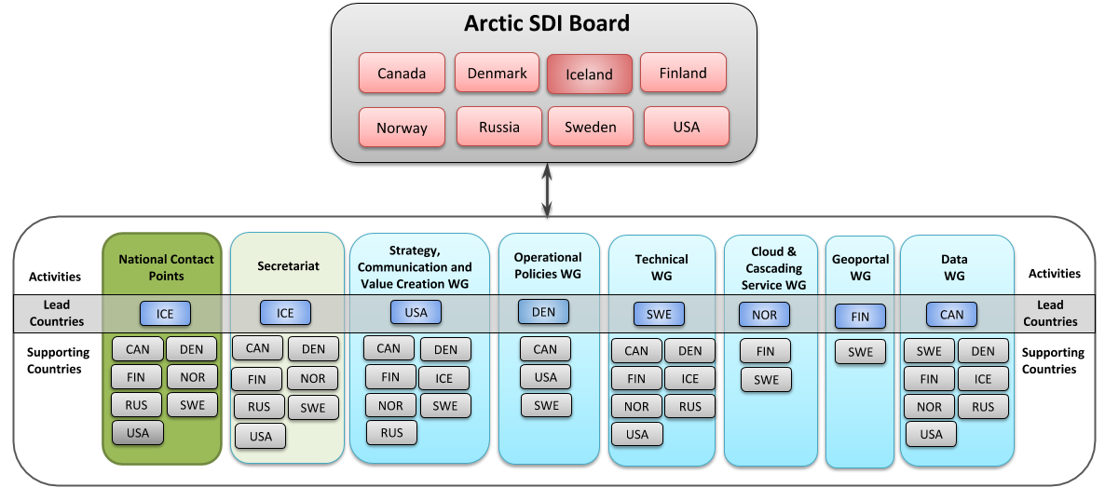
Arctic SDI Governance
Notes:
Iceland is the current chair of Arctic SDI. The chairship rotates every 2 years following the order defined by Arctic Council
The decision-making body of the Arctic SDI cooperation is the Arctic SDI Board. The Board consists of one Director General or deputy Director General from national mapping agencies of the Arctic countries. The present status of the Arctic SDI cooperation is a voluntary cooperation between national mapping agencies. The activities are be performed by Lead Countries joined by Support Countries. The Lead Countries have the responsibility for the operation and progress of the specific activity and refers directly to the Board. Canada is leading of the Data WG

Slide 11
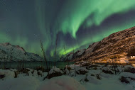
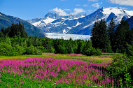
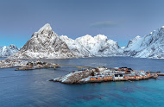
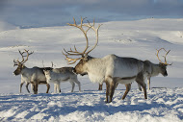
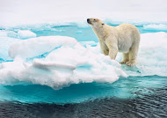
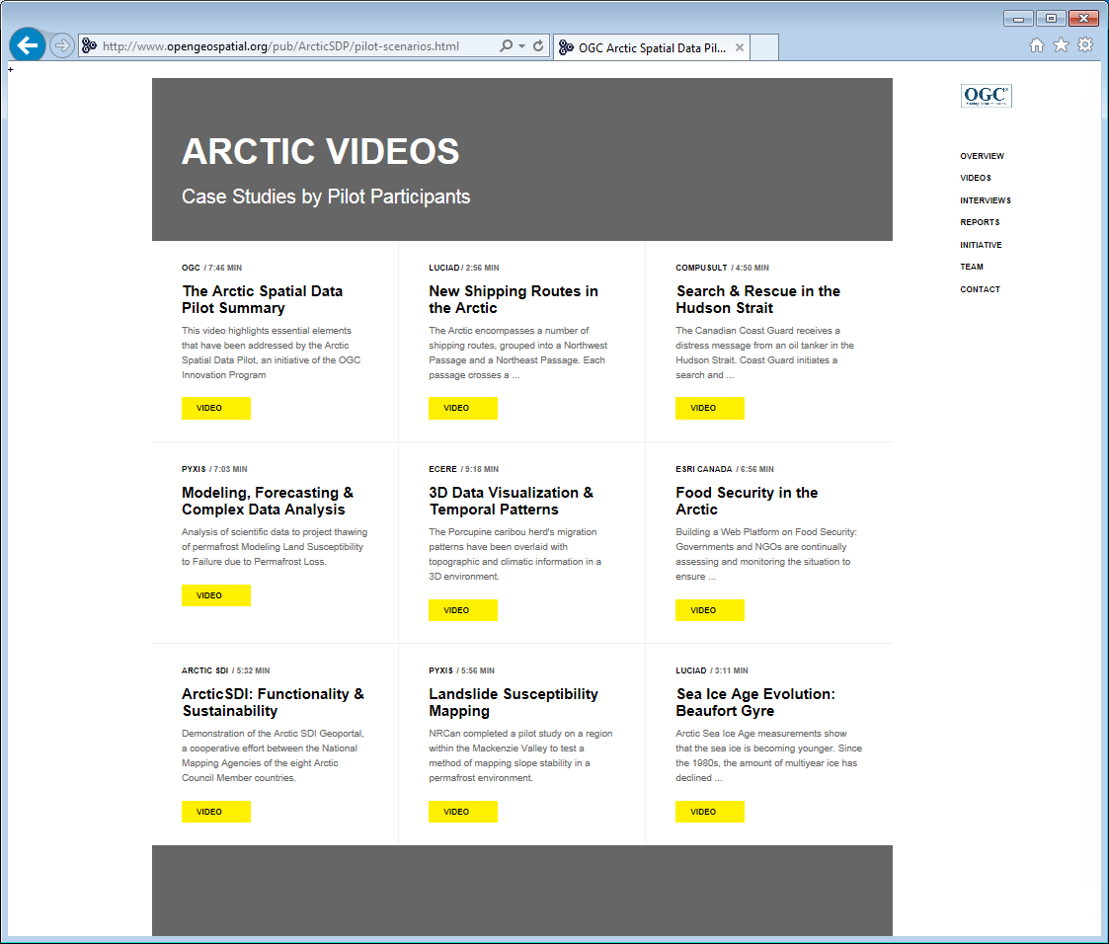
Arctic Spatial Data Pilot - Videos
http://www.opengeospatial.org/projects/initiatives/arcticsdp
VIDEOS
Case Studies by Pilot Participants
Notes:
For the use cases…

Slide 12
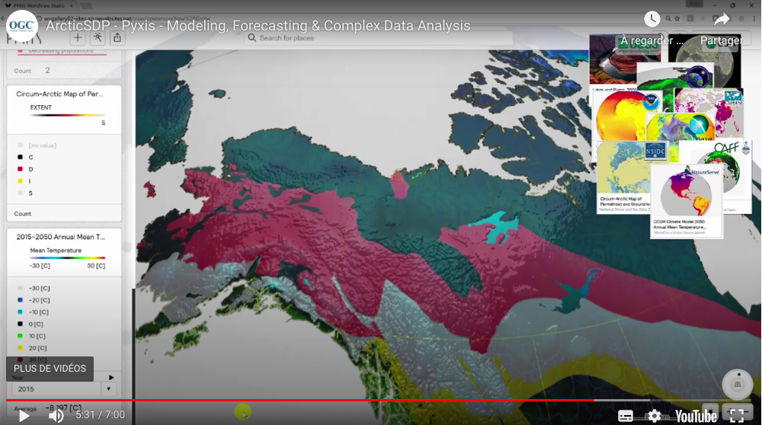
Climate Change in the Arctic Predictive Modelling
Distributed analytical process
Replicated Geological Survey of Canada science paper (Riopel et al.)
Use of Discrete Global Grid System standard to query numerous Canadian and USA data sources
Modeling Land Susceptibility Failure due to Permafrost Loss in 2050.
Repeatable science
4.55 to 6.24
Open standards + Open data = Open Science
Notes:
https://www.youtube.com/watch?v=WRqHvia1eBs&feature=youtu.be&t=295
4.55 to 6.24

Slide 13
The Landscape of Complex Adaptive Systems¹
The government has put a renewed emphasis on ensuring access to science-based evidence to understand and address priorities such as climate change, clean innovative technologies, environmental assessments and continental approaches.
Instances of the Canadian Geospatial Data Infrastructure includes:
the Federal Geospatial Platform,
Canadian inter-jurisdictional co-ordination via the Canadian Council on Geomatics,
the circumpolar Arctic Spatial Data Infrastructure and liaison with Arctic Council
and foundational standards, operational policies and assessment methods for a Marine Spatial Data Infrastructure.
SDIs are critical to the sharing of data across numerous domestic and international jurisdictions in support of Arctic Council ecosystem based analysis.
F/P/T Land Data
Marine, Federal, International
Indigenous
DigitalArctic
You!
Geology, Forestry, Atmosphere
Academic
Arctic
Council
1. L. Grus 2010
Notes:
The government has a renewed interest in science based understanding to address issues related to climate change, clean tech, the environment,
The Arctic SDI is a system of systems, with a variety of partners and components, including the Canadian geospatial data infrastructure, composed of southern Canadian components of sdi, the marine sdi, the coastal areas of Canada managed by DFO, the FGP which is the federal node of the CGDI, the world meteorological organisation, which provides valuable meteorological data and services, and the Arctic Council.
The arctic council is the high level intergovernmental forum that addresses issues faced by the Arctic governments and the Indigenous Peoples of the Arctic.
We see in this slide the connections between the various partners, and that there is much overlap amongst the partners. CCADI is a member of this system and is performing the service of making academic information and data more available as a service to the partners.

Slide 14
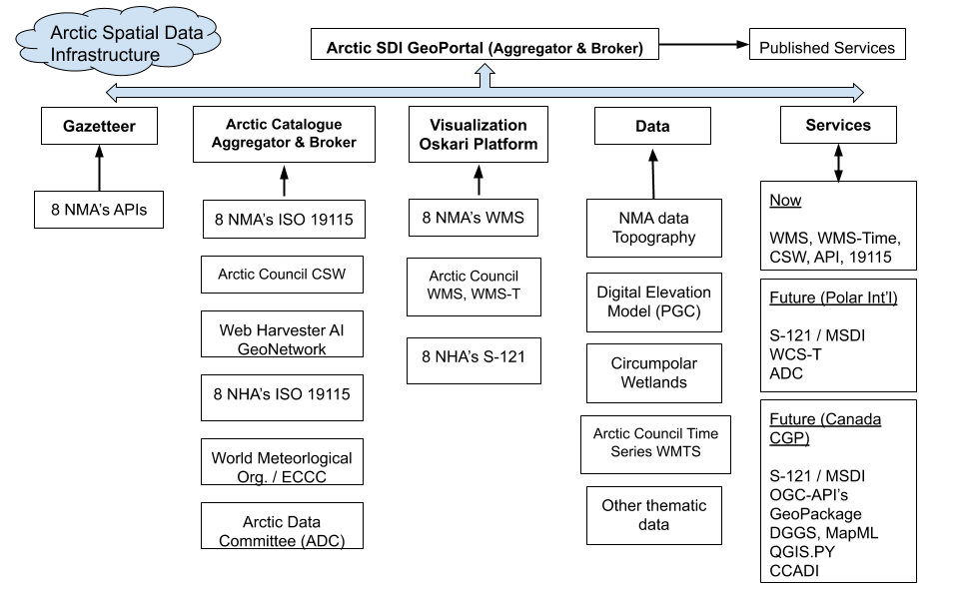
Notes:
NMA:
National Mapping Agency
NHA:
National Hydrographic Agency
(Canada, USA, Russia, Iceland, Norway, Denmark, Finland, Sweden)
Notes:
The Arctic SDI provides brokers access to:
Cascading catalogue of catalogues (ISO 19115)
Web Harvestor and AI Filters, Catalogue Service for the Web (CSWs)
Authoritative reference data as a cascading Web Map Service (WMS) 1:250,000
Spatial data viewing and discovery
Thematic data (birds, ice cover, ship routes, land cover change, flora etc.)
Acronyms:
Legend:
NMA = National Mapping Agency from Canada, USA, Russia, Finland, Sweden, Norway, Iceland, and Kingdom of Denmark.
NHA = National Hydrographic Agency from Canada, USA, Russia, Finland, Sweden, Norway, Iceland, and Kingdom of Denmark.
ISO = International Organization for Standardization
ISO 19115 – ISO metadata standard
CSW = Catalogue Service for the Web
AI = Artificial Intelligence
WMS-T = Web Mapping Service – Temporal
PGC = Polar Geospatial Centre, University of Minnesota's College of Science and Engineering, National Science Foundation funded.
MSDI = Marine SDI
QGIS.PY = QGIS Python modules
S-121 = Suite of hydrographic standards (IHO)
IHO = International Hydrographic Organization.
CCADI = Canadian Consortium for Arctic Data Interoperability
DGGS = Discrete Global Grid System
MapML = Map Markup Language
OGC-API’s are a suite of OGC standardized APIs that are in early stages of adoption
WCS-T = Web Coverage Service – Temporal

Slide 15
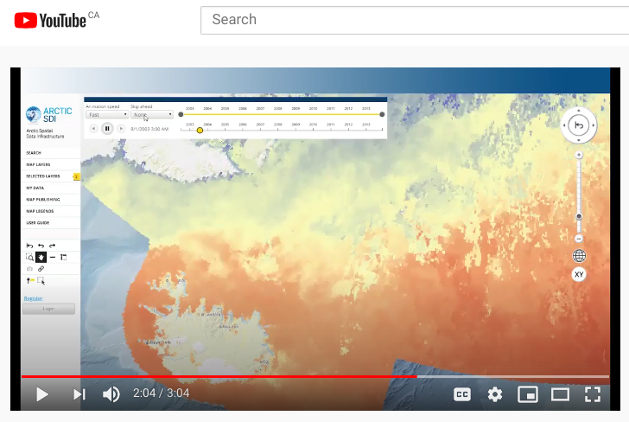
Arctic SDI Geoportal
MODIS Sea Surface Temperature Time Series “is a 4 km resolution global monthly composite based on 1 km daily imagery” (2002-2013)
A network of networks of data feeds from land, sea, & science communities
OGC, ISO & IHO standards compliant data feeds
Functionalities:
Time series data support
Circumpolar place names: Roman, Syllabics and Cyrillic characters
6 polar projections
Seamless topographic service
Embedded Maps Wizard (API)
Location Search
Metadata Search
Map Layers & Coordinate Tool
Your Own Maps
Tabular data spatial join
GeoPortal application (Oskari) is standards based and code is open source
https://youtu.be/Ytf3ahdvMms?t=111
1.51 to 2.13: Sea Surface Temperature Time Series (2002-2013)
Arctic SDI Geoportal Video: https://youtu.be/K8xRbNiGgRs
Notes:
The Arctic SDI provides the behind-the-scenes connectivity needed to power and deliver data and maps via an online geoportal, similar to the electrical networks that we rely on daily.
The Arctic SDI Geoportal is the access point that allows users to combine data from many different sources, create customized thematic and statistical maps and share these on their own websites as digital, interactive and embedded maps.
The Geoportal provides access to a place name search tool with three million Arctic place names, available in Latin, Cyrillic (Russian) and Syllabic (Inuit) character sets.
The Geoportal features for example a Time Series tool, which can be used to visualize various phenomena: video time stamp 1.51 to 2.13: Sea Surface Temperature Time Series (2002-2013)
------------------
https://www.abds.is/index.php/land-cover-change-index-docman/seasurfacetemperature
“The MODIS Sea Surface Temperature (SST) product provided is a 4 km resolution global monthly composite based on 1 km daily imagery. The imagery is from the MODIS Aqua satellite, and represents the 4 um nighttime measurements. Nighttime measurements provide a more accurate representation of the sea temperature, because during the day the top few centimeters of the water column may be affected by sunlight warming, while nighttime measurements do not have this factor of error. However, this may be less of an issue in the Arctic, due to continuous solar illumination during the ice-free months, but it is common practice to use the nighttime measures for SST.”
Suggested citation: CAFF (2015). Sea Surface Temperature: Arctic Land Cover Change Index. Conservation of Arctic Flora and Fauna, Arctic Biodiversity Data Service (ABDS).
Next step: analytics and predictive modelling

Slide 16
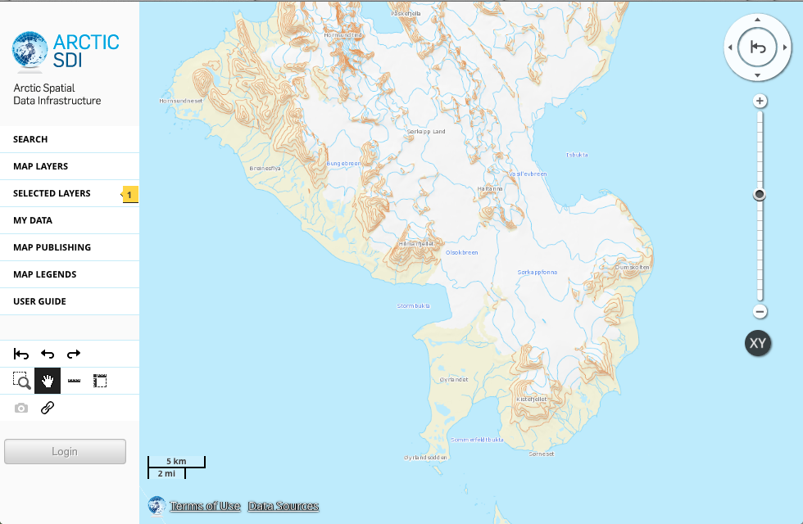
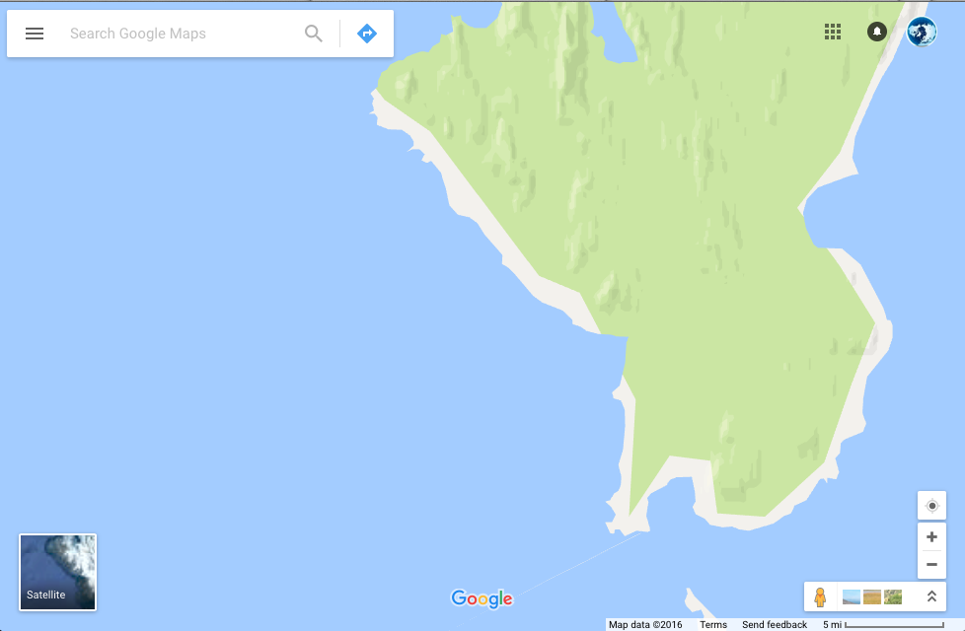
Authoritative Topographic Basemap
Provided Directly from the
8 Arctic National Mapping Agencies
Southern Svalbard:
Arctic SDI Basemap
vs.
Google Maps
Common Cartographic Specification
A Trusted Source of Detailed Information
Notes:
Arctic SDI is the trusted source of authoritative Topographic information from the Arctic area, provided by the 8 Arctic National Mapping agencies. As you can see in this comparison of the Arctic Topographic Basemap and Google, the Arctic SDI on the left provide more information such as the elevation contours, rivers and lakes, and placenames Also, the Arctic SDI basemap is rendered using a common cartographic specification which result in a unified view over the entire Arctic.
Arctic SDI works with many other authoritative data suppliers; ranging from each nations’ environment departments, national SDI’s, Arctic Council working groups data...especially Conservation of Arctic Flora and Fauna (CAFF) and other international associations (INSPIRE etc.)

Slide 17
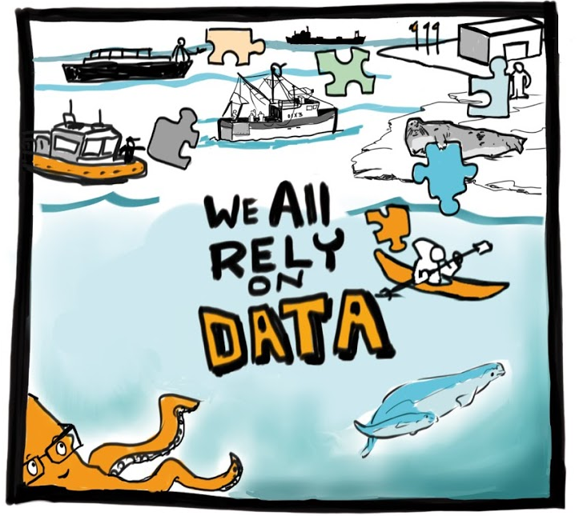

We Are All Stakeholders
Arctic SDI offers a model for our Canadian Arctic and remote landscapes that can be mobilized domestically
Important datasets over the Arctic are produced and distributed by many stakeholders. A Data Fire Hose.
The glue of successful regional SDI implementation is governance and standards, which enables,
Ecosystem-based analysis with seamless sharing of data across jurisdictions and organizations.
Join us as we build a multidimensional 2025 Digital Arctic over land, sea, atmosphere, science and people.
Source: blogs.vmware.com
Ecosystem-based analysis requires seamless sharing of data across jurisdictions and organizations.
Notes:
Arctic SDI brings together trusted location data and geospatial data expertise.
Important datasets are produced and distributed by many stakeholders – public and private sector.
The glue of successful regional SDI implementation is governance and standards.
Ecosystem-based analysis requires seamless sharing of data across jurisdictions and organizations.
The Arctic SDI initiative enables monitoring, mitigation and management of climate change impacts as well as supports community resiliency and Indigenous reconciliation.

