Slide 1


SDI 2020:
Responding to needs of Northern remote communities
Strengthening community-based technical capacity for regional land use planning in the NWT

Slide 2
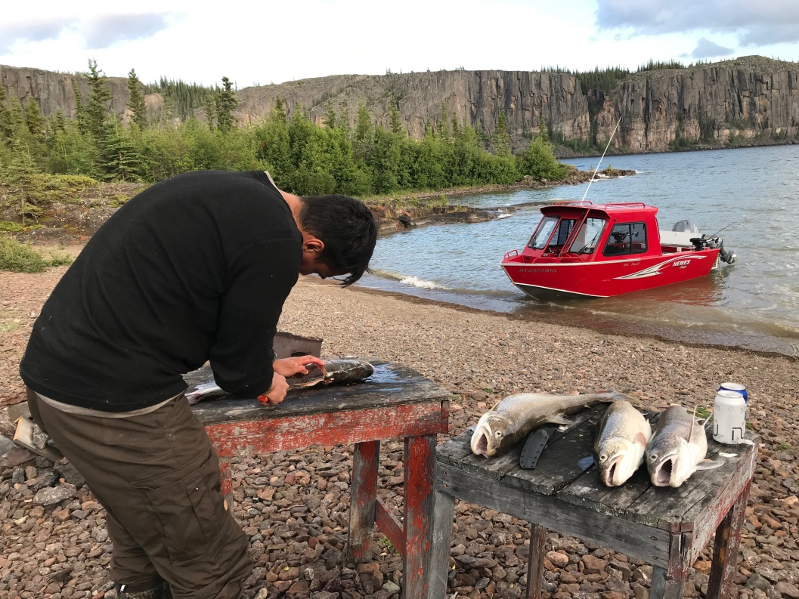
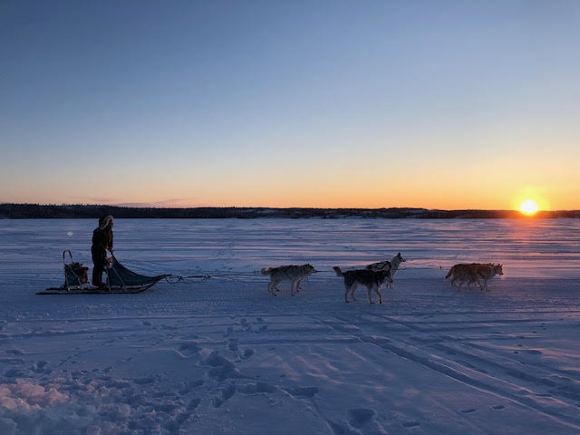
Let me introduce myself
Noni Paulette:
Senior land use planner
Land Use Planning Unit
Department of Lands
Government of the Northwest Territories

Slide 3
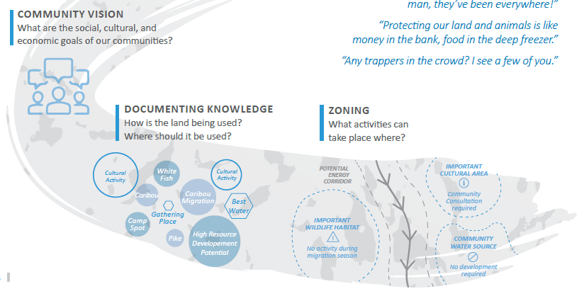
Regional land use planning in the NWT
Regional Land Use Planning
GNWT
Government of Canada
Indigenous Governments
Non-Government Organizations
Regulatory Boards
Communities

Slide 4
NWT land use planning forums
Annual opportunity for planning partners:
Indigenous governments and organizations (IGOs).
Regulators.
Territorial and Federal Government.
NGOs.
Purpose: Share and discuss information on regional land use planning in the NWT.
Recurring theme (2017, 2018):
A need to strengthen technical capacity of
IGOs to participate in land use planning processes

Slide 5
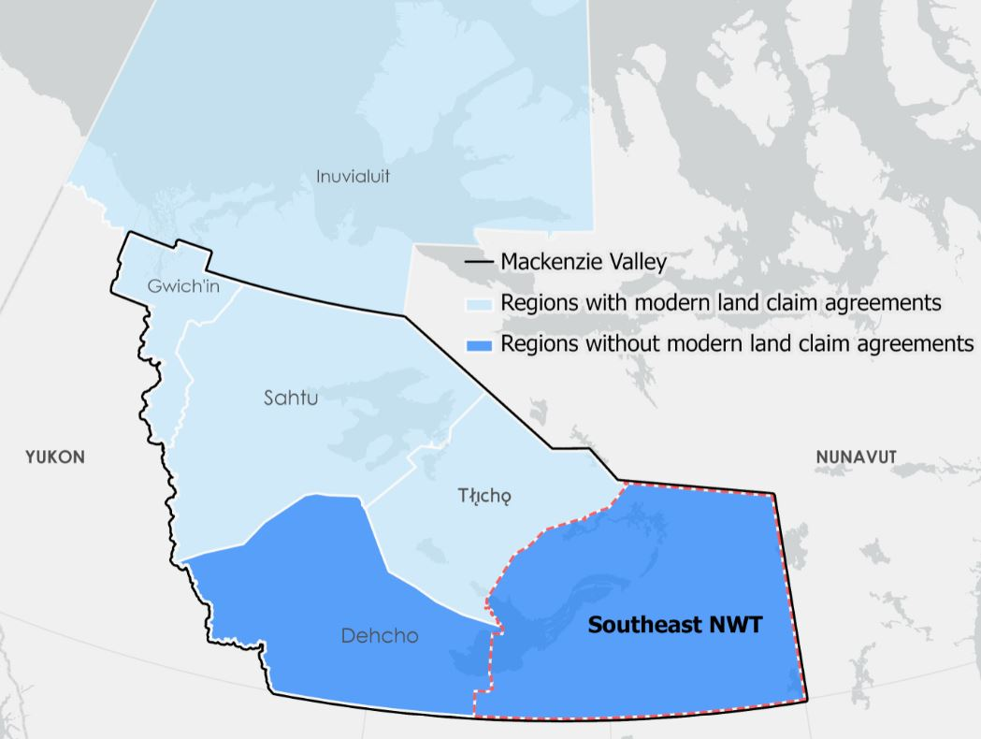
Southeast NWT: Strengthening technical capacity for IGOs
No regional land use plan.
Numerous IGOs with traditional territories.
Technical capacity issues noted among IGOs in the region.

Slide 6
Community visits
GIS needs assessment for southeast NWT: Four communities, seven IGOs.
Common issues and limitations:
Technical capacity: Staff, expertise and resources.
Data access and management.

Slide 7
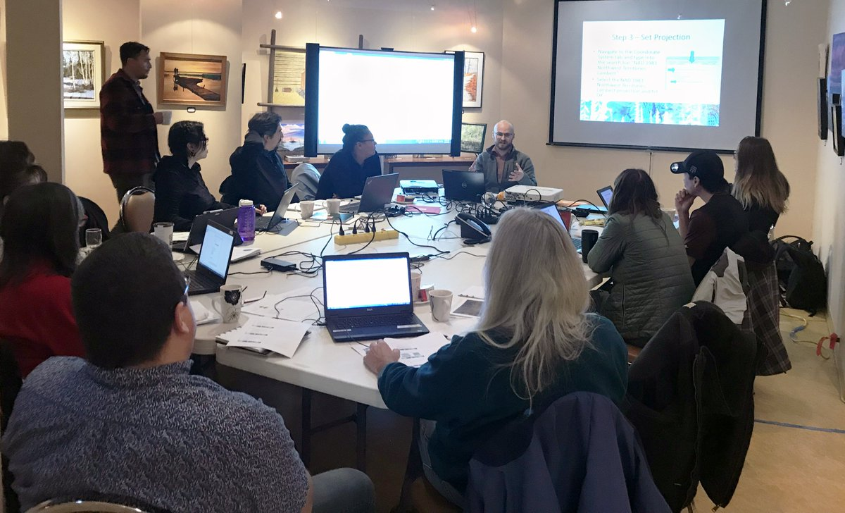
GIS workshops – four to date
1st GIS workshop – November 2018: 10 participants (seven IGOs)
Learning environment:
Group discussion.
2. Presentation & guest speakers.
3. Laptops for tutorial-based GIS
exercises.

Slide 8
Practical skills:
Introduction to GIS mapping.
Geospatial analysis: local data and northern context.
Cartography
Presentations:
Group discussion.
Presentations & guest speakers.
Laptops for tutorial-based GIS exercises.

Slide 9
Additional Support:
2. Direct technical support for staff at IGOs
3. Indigenous Mapping Workshop, 2019 in Inuvik

Slide 10
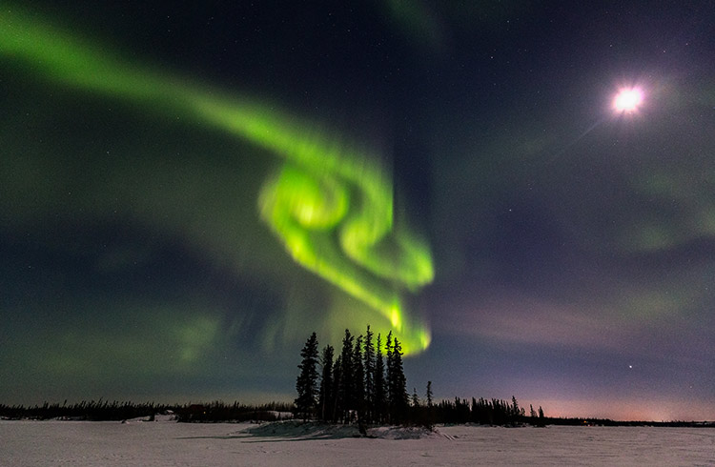
Summary and thank you
Noni_Paulette@gov.nt.ca

